Slide 1
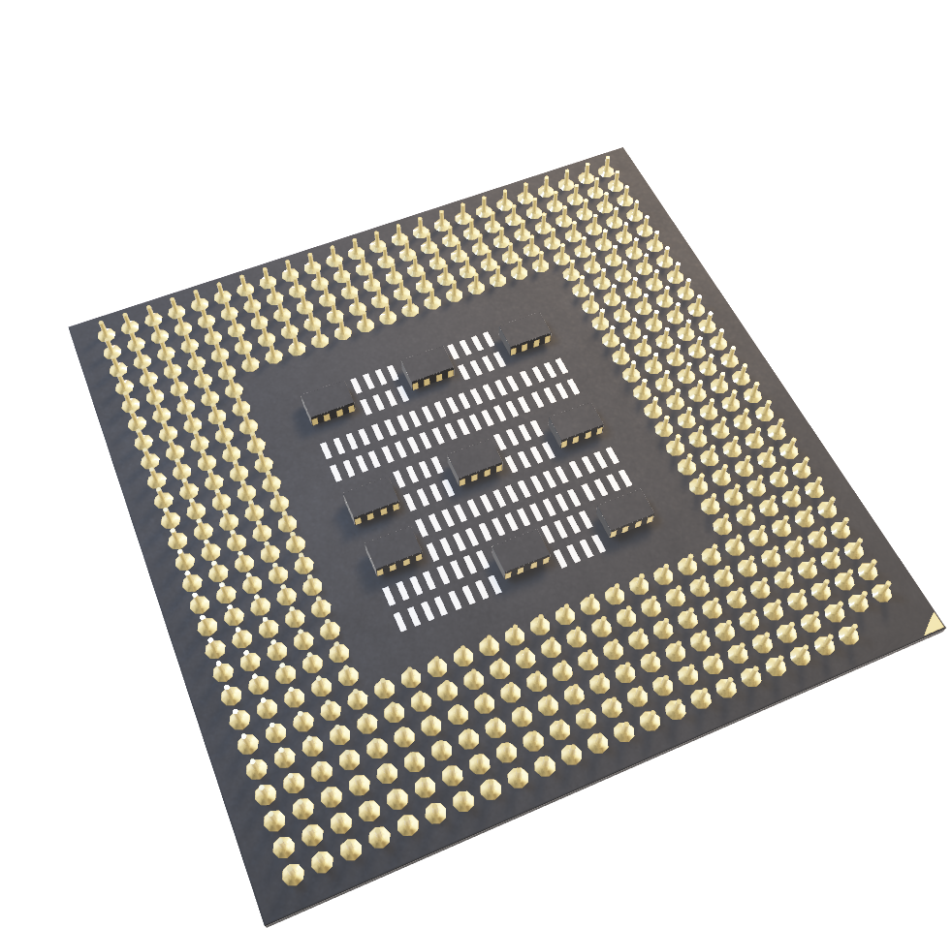
Anatomy of CPU
Prepared by : Meet Solanki

Slide 2
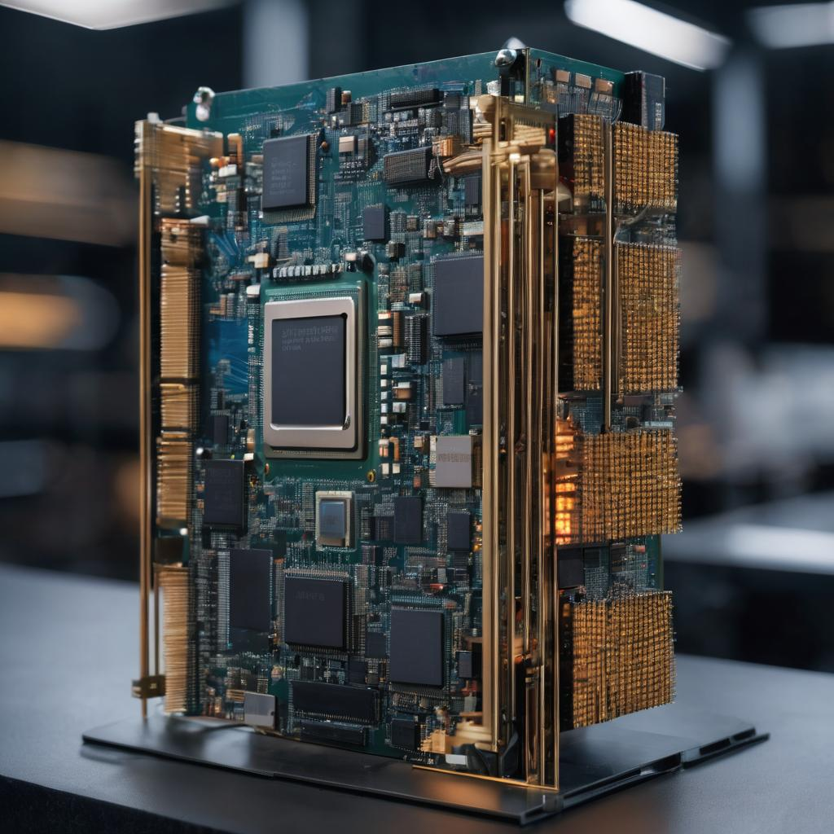
Introduction
It's common to refer to the CPU as the "brain" of a computing system.
It is essential to control how complicated computations and commands are carried out.
We will examine the inside workings of a CPU in this presentation, learning about its parts and how CPU technology affects practical uses.

Slide 3
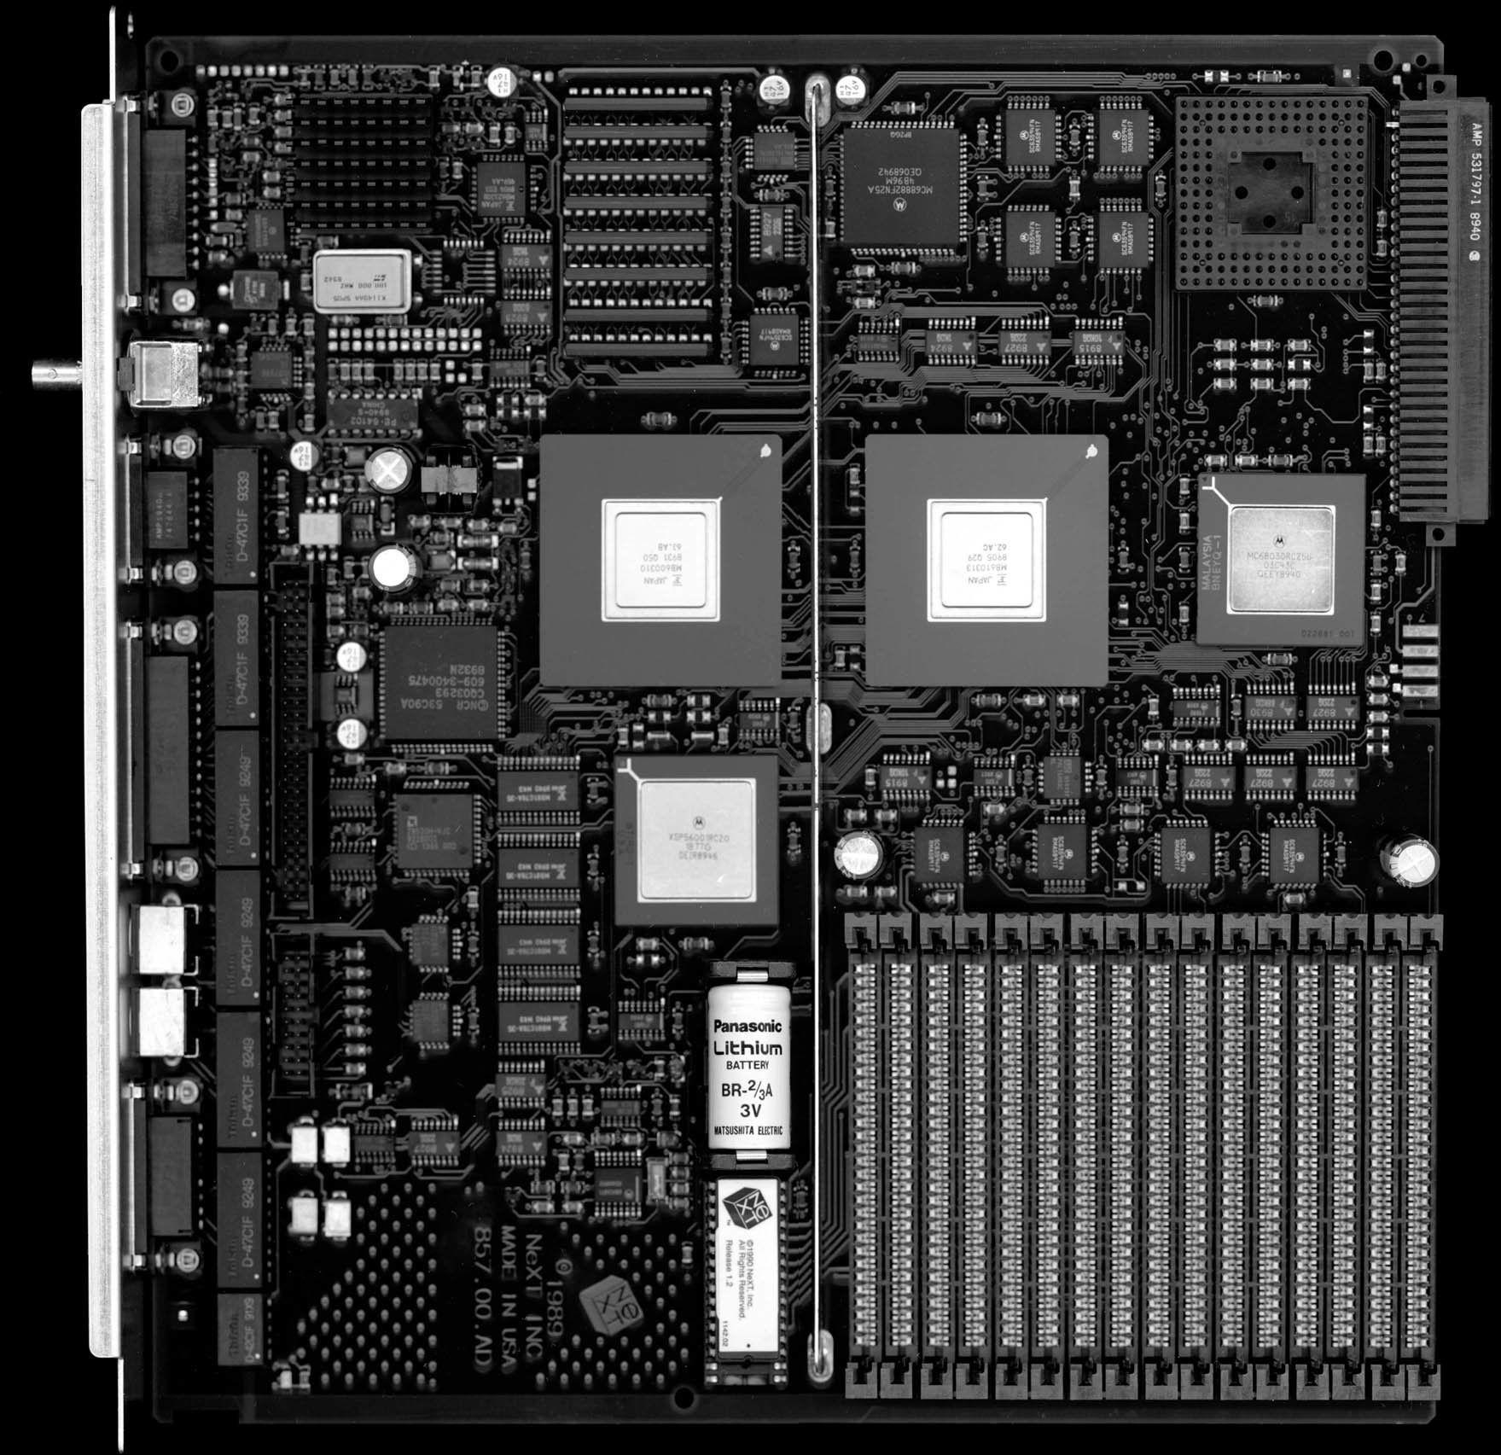
CPU Components
CPU consists of critical components:
Control Unit (CU): Manages instruction flow.
Arithmetic Logic Unit (ALU): Performs math and logic operations.
Registers: Temporary data storage.
Memory Management Unit (MMU): Manages memory.
Control Bus and Data Bus: Enable data flow.
Cache Memory: Quick-access data storage.

Slide 4
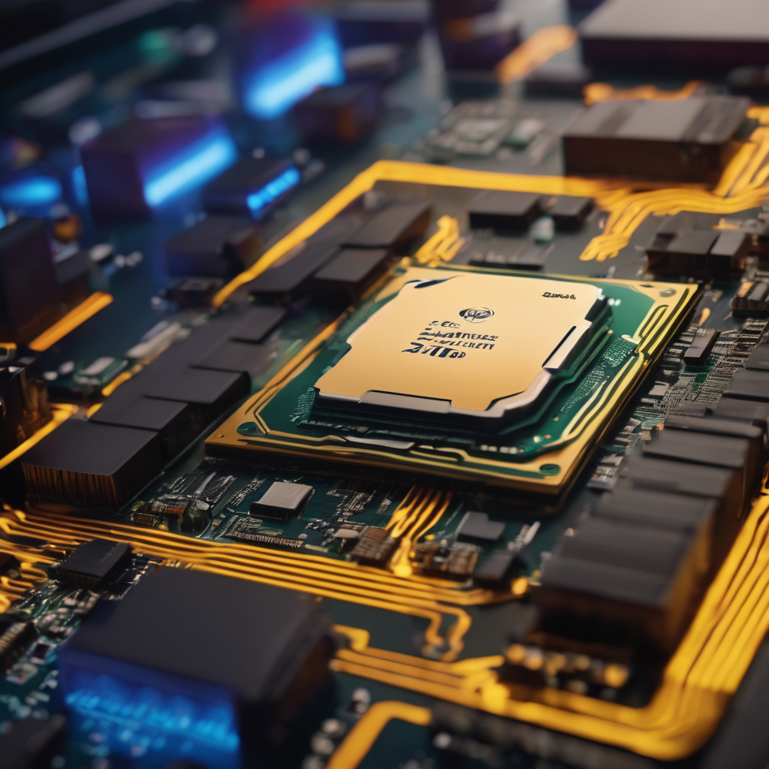
How CPU Executes a Task
CPU task execution is a precise process.
Steps:
Control Unit initiates.
Instruction Register reads.
CU identifies and decodes.
ALU performs calculations.
CU communicates with MMU.
Cache and MMU ensure data.
Registers for data transfer.
Control Bus coordinates.
Pipelining ensures efficiency.

Slide 5
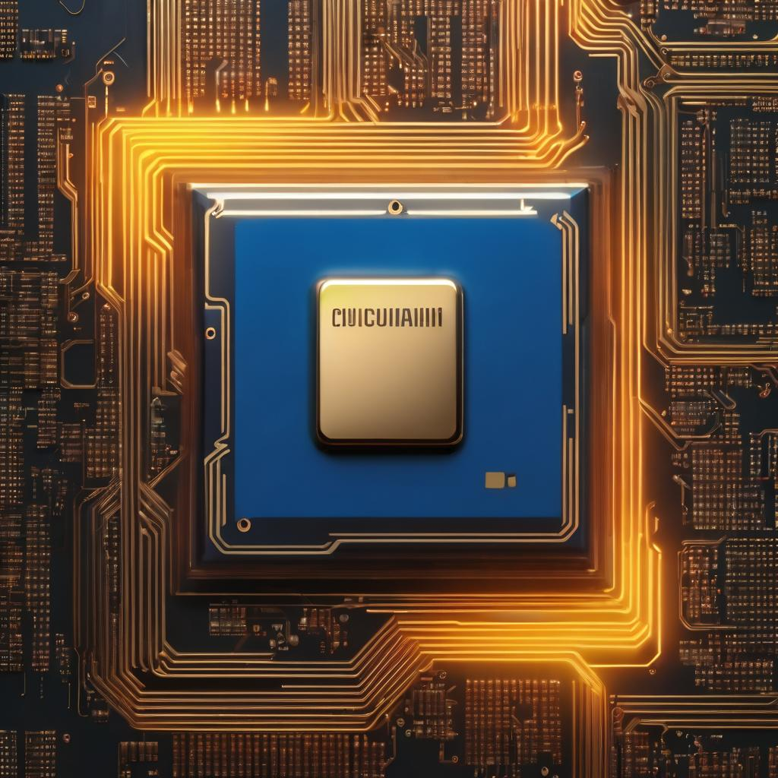
Importance of CPU
CPU evolution led to faster, energy-efficient processors.
Key milestones: Transistor miniaturization, multi-core processors, pipelining, specialized instructions, and co-processors.
Impact: Enhanced processing power, parallel execution, reduced execution time, and optimized performance.

Slide 6
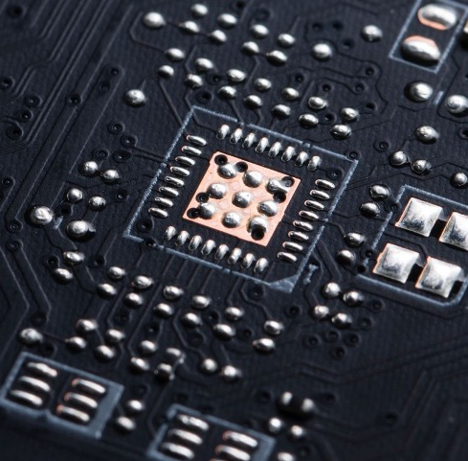
Overcoming CPU Performance Challenges
CPU performance can face challenges, but these can be addressed for optimal functionality:
Heat Dissipation: Excessive heat can shorten CPU lifespan and stability. Adequate cooling solutions, like heat sinks and fans, are essential for thermal management.
Parameter Settings: Incorrect voltage or frequency settings can jeopardize CPU stability. Ensure settings align with CPU specifications.
Mainboard Jumper Settings: Incorrect mainboard jumper settings can interfere with CPU operation. Follow motherboard documentation closely.
Physical Damage: Physical damage, like oxidation, dust accumulation, or pin breakage, can harm the CPU. Regular maintenance and careful handling mitigate these risks.
Addressing these challenges ensures CPU performance and longevity.

Slide 7
Conclusion
In conclusion, the CPU is the central component of computing systems, responsible for executing commands and intricate calculations.
CPU technology has evolved significantly, leading to faster, more efficient processors.
CPU performance directly impacts user experience, multitasking, and real-time applications.
Ongoing CPU technology evolution continues to shape the digital age.

